Slide 1

Undergraduate Division
Faculty of Business
Leave Procedures

Slide 2
Student Leaves
Leave During Semester (Not Falling in Final Exam Duration)
Leave During Final Exam Duration

Slide 3
Leave During Semester (Not Falling in Final Exam Duration)

Slide 4
Leave During Semester (Not Falling in Final Exam Duration)
Students can request for leave
  Case 01 - During Semester (Where it does not fall in the final exam duration and leave requested is less than 3 weeks)
  Case 02 - During Semester (Where it does not fall in the final exam duration and leave requested is more than 3 weeks)
In Case 01, UGS advises the student to discuss the leave with relevant HOD and relevant lecturers to make up the missed lectures and CA components. If HODs request evidence, please submit to them.
However, if it is overseas leave, then even if it is less than 3 week, you still need to follow the procedure given in Case 02.
In Case 02, Students need to apply for “Long Term Leave” which will be sent for approval of FAC and Senate.

Slide 5
Case 02 – Long Term Leave During Semester
You can apply for long term leave (>3 weeks) for following reasons only.
The most important thing to remember is that when you apply for “Long Term Medical leave” the Senate will give “Concession” for the whole semester. That means all your semester work and assessments will be made null and void. You can re-enroll for the same semester with next batch as first attempt candidate
Reason for Leave | Compassionate Ground: Official Representation of University
Medical Leave | A medical reason which the Doctor recommends a time period of more than three weeks of leave.
Compassionate Ground | An unforeseeable event that affect student’s ability to study (including medical reasons of immediate family).
Official Representation of University | This only applies to situations where you represent the UoM.

Slide 6
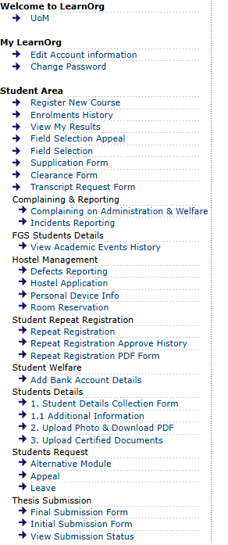
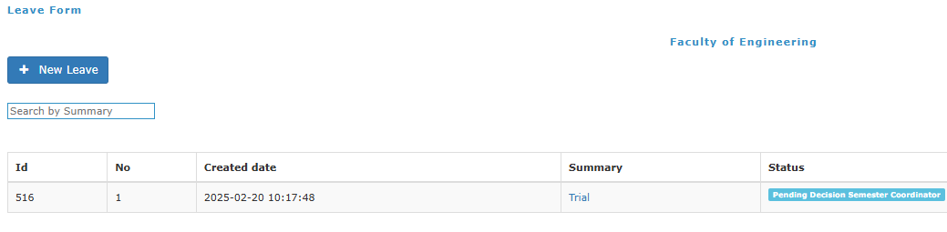
Case 02 – Long Term Leave During Semester
Procedure
Step 01 - Go to your LMS page and click on “Apply for Leave”. Then Click on “New Leave”

Slide 7
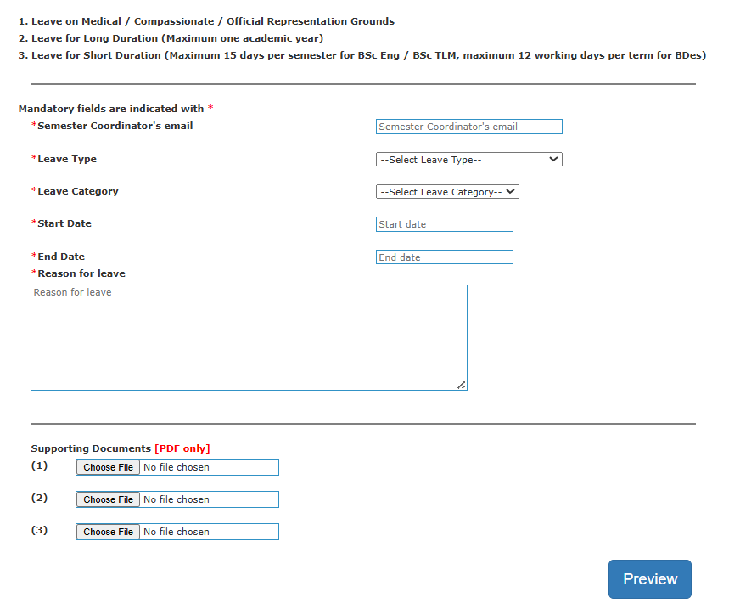
Case 02 – Long Term Leave During Semester
Step 02 - Fill in the details. Give a good description of leave.
Put you semester coordinator’s email. If you do not know that put your HOD’s email.
Attach Supporting documents such as medicals of you, medicals of family, invitation for participation, visa page of passport or any other document that is deemed necessary to support the claim.

Slide 8
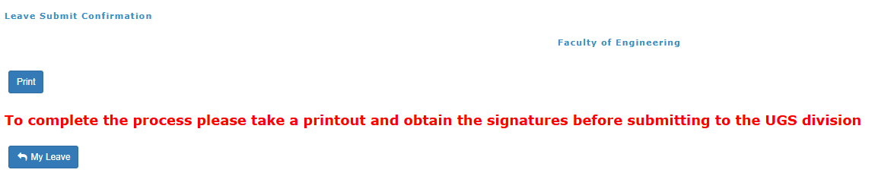
Case 02 – Long Term Leave During Semester
Step 03 - Press “submit” and then “print” to generate the combined PDF.
Then student should digitally sign the form with date. No need to get recommended signatures of other officers.

Slide 9

Case 02 – Long Term Leave During Semester
Step 04 – Visit UGS website (https://uom.lk/business/undergraduate-studies) and fill the Google form under “Student Requests for FAC”. Submit the pdf generated in Step 03 as attachment.
A sample leave request form is available in the website.
Your Leave Application is done now. DUGS will get an email notification of the request and will be discussed in the next month FAC.

Slide 10
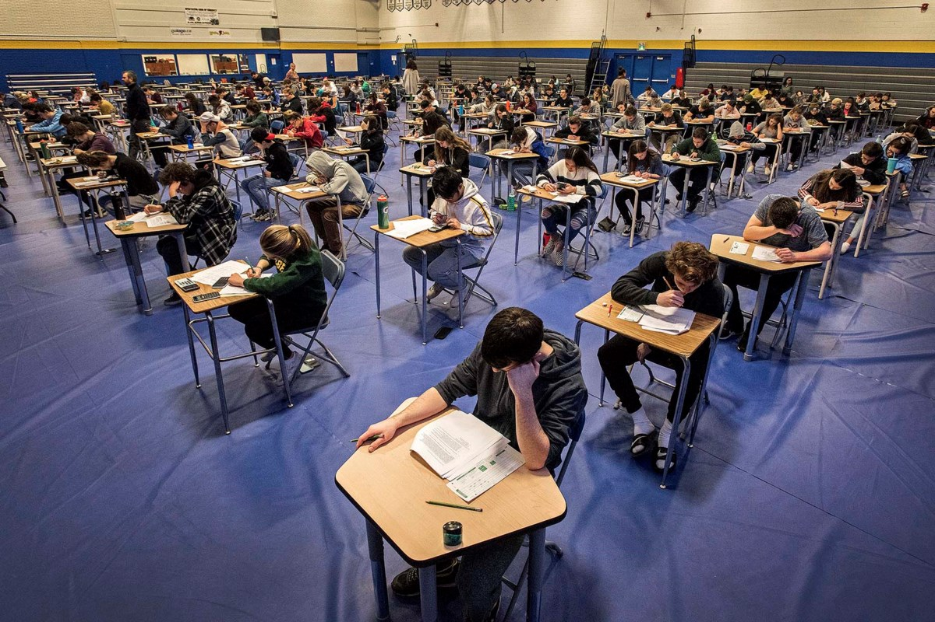
Leave During Final Exam Duration

Slide 11
Leave during exam duration
Final exam is handled directly by Exam division of UoM and you need to apply the leave to them.
Final Exam Leave is granted only for following situations
  Medical Leave
  Compassionate Ground
  Official Representation of University
Case 1 – When incidence is predictable and known to happen in the exam scheduled dates (Surgery planned, representing university in a game etc.)
Case 2 – Unexpected incidence during exams (Sudden illness, Illness of a family member, floods, accidents etc.)

Slide 12
Case 1 – When incidence is predictable and known to happen in the exam scheduled dates
Step 01 - Inform the DR/Exams about the planned incidence by writing an email to sar-exams@uom.lk (cc to pramodaj@uom.lk) before the commencement of the exams. In case of official representation, it should be submitted before one month of the commencement of the exams.
Step 02 - Fill the form “Application for Academic concession for Examinations” available at https://uom.lk/exams/downloads. The same form can be used for medical, compassionate and representative grounds.
Step 03 - Submit the hard copy of the signed form with evidence of informing the DR/Exams (Step 01 – hard copy of email) and evidence documents in a sealed envelop.

Slide 13

Case 2 – Unexpected incidence during exams
1. Sudden medical condition within the final exam time period
Step 01 - Student (or parents or guardian) need to inform the sar-exams@uom.lk (cc to pramodaj@uom.lk) within 7 days of the illness. No need of any medical attachments with email.
Step 02 - Fill the form “Application for Academic concession for Examinations” available at https://uom.lk/exams/downloads.
Step 03 - Submit the hard copy of the signed form with evidence of informing the DR/Exams (Step 01 – hard copy of email) and medical documents before one month of last date of the exam in a sealed envelop.
If a student miss only one module: A Medical Certificate (MC) from the UMO or any MO is OK. Medical evidence such as results of investigations (e.g blood counts/CRP) can be attached for clarity but not compulsory
If a student miss more than one module:
  If treated from UOM medical center: You need a MC from the UMO OR
  If treated from a government hospital: You need a MC with the diagnosis card. If no diagnosis card is available, documents for medical evidence are essential OR
  If treated from a private hospital: You need a MC from a consultant with the diagnosis card, prescription for drugs and evidence of investigations

Slide 14
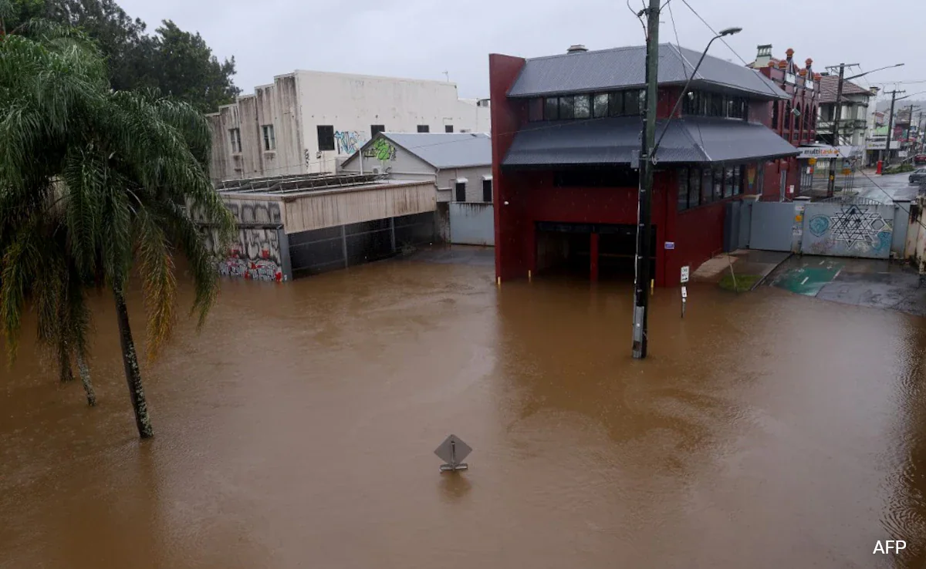

Case 2 – Unexpected incidence during exams
Sudden compassionate condition within the final exam time period
Same procedure should be used for Compassionate Grounds requests as well.
It is very unlikely that exam division will give leave for reasons which are of non-medical or non-compassionate (e.g foreign trip to visit family, wedding of brother/sister)

